Slide 1
Threads

Slide 2
Threads
A thread (or lightweight process) is a basic unit of CPU utilization; it consists of:
program counter
register set
stack space(what functions it is calling they are private for each thread
,temporary variables)
A thread shares with its peer threads its:
code section
data section
operating-system resources
A traditional or heavyweight process is equal to a task with one thread

Slide 3
Threads (Cont.)
In a multiple threaded task, while one server thread is blocked and waiting, a second thread in the same task can run.
Cooperation of multiple threads in same job confers higher
throughput and improved performance.
Applications that require sharing a common buffer (i.e., producer-consumer) benefit from thread utilization.
MOTIVATION:
Many software packages that run on modern computers are multithreaded.
In web browser, one thread displays images, other text, other
fetches data from network.
Word processor, graphics, response to keystrokes, spell check.

Slide 4
Benefits of Threads vs Processes
If implemented correctly then threads have some advantages of (multi) processes, They take:
Less time to create a new thread than a process, because the newly created thread uses the current process address space.
Less time to terminate a thread than a process.
Less time to switch between two threads within the same process, partly because the newly created thread uses the current process address space.
Less communication overheads -- communication between the threads of one process is simple because the threads share everything: address space, in particular. So, data produced by one thread is immediately available to all the other threads.

Slide 5
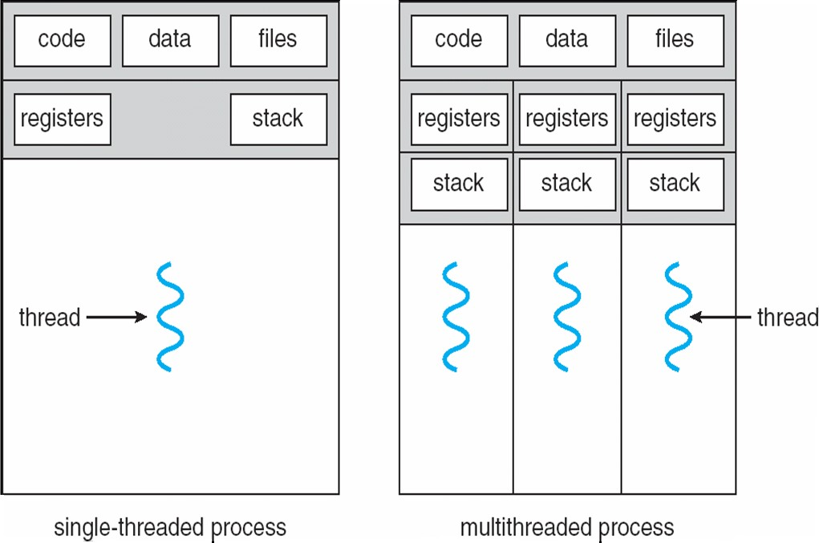
Single and Multithreaded Processes

Slide 6
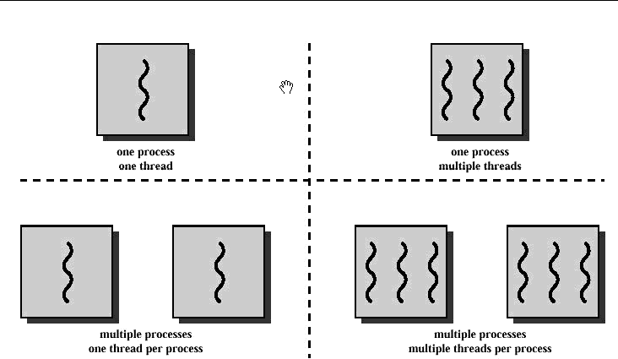
Single threading-- when the OS does not recognize the concept of thread Multithreading-- when the OS supports multiple threads of execution within a single process

Slide 7
Some example popular OSs and their thread support is:
MS-DOS-- support a single user process and a single thread
UNIX-- supports multiple user processes but only supports one thread per process
Solaris-- supports multiple threads

Slide 8
Benefits
Responsiveness:: Multithreading an interactive application may allow a program to continue running even if part of it is blocked or is performing a lengthy operation, thereby increasing responsiveness to the user. For instance, a multithreaded web browser could still allow user interaction in one thread while an image is being loaded in another thread
Resource Sharing: By default, threads share the memory and the resources of the process to which they belong. The benefit of code sharing is that it allows an application to have several different threads of activity all within the same address space
Economy: Allocating memory and resources for process creation is costly. Alternatively, because threads share resources of the process to which they belong, it is more economical to create and context switch threads. It can be difficult to gauge empirically the difference in overhead for creating and maintaining a process rather than a thread, but in general it is much more time consuming to create and manage processes than threads. In Solaris 2, creating a process is about 30 times slower than is creating a thread, and context switching is about five times slower.
Scalability: One thread runs on one CPU. In Multithreaded processes, threads can be distributed over a series of processors to scale.
Context Switching is smooth. Context switching refers to the procedure followed by CPU to change from one task to another.

Slide 9
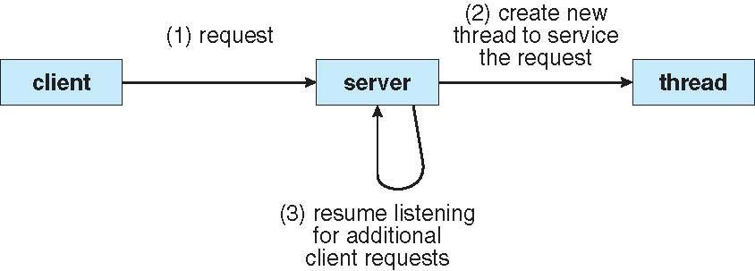
Multithreaded Server Architecture

Slide 10
User Level Threads(ULT)
In this level, the kernel is not aware of the existence of threads -- All thread management is done by the application by using a thread library.
Thread switching does not require kernel mode privileges (no mode switch) and scheduling is application specific.
Three primary thread libraries:
POSIX(Portable Operating System Interface for Unix) Pthreads
Win32 threads
Java threads

Slide 11
Advantages:
• User-level threads do not require modification to operating systems.
• Simple Representation: Each thread is represented simply by a PC, registers, stack and a small control block, all stored in the user process address space.
• Simple Management: This simply means that creating a thread, switching between threads and synchronization between threads can all be done without intervention of the kernel.
• Fast and Efficient: Thread switching is not much more expensive than a
procedure call.
Disadvantages:
• There is a lack of coordination between threads and operating system
kernel.
• User-level threads require non-blocking systems call i.e., a
multithreaded kernel.

Slide 12
Kernel Level Threads(KLT)
In this level, All thread management is done by kernel.
No thread library but system calls to the kernel facility exists.
The kernel maintains context information for the process and the threads,
switching between threads requires the kernel.
Scheduling is performed on a thread basis.
Kernel-level threads allow a thread to run while another thread in the same process is blocked in a system call; processes with user-level threads must take care not to make blocking system calls, as these block all the threads of the process.

Slide 13
Advantages:
• Because kernel has full knowledge of all threads, Scheduler may decide to give more time to a process having large number of threads than process having small number of threads
. • Kernel-level threads are especially good for applications that
frequently block.
Disadvantages:
The kernel-level threads are slow and inefficient. For instance, threads operations are hundreds of times slower than that of user-level threads. Since kernel must manage and schedule threads as well as processes. It require a full thread control block (TCB) for each thread to maintain information about threads. As a result there is significant overhead and increased in kernel complexity.

Slide 14
Multithreading Models
Many systems provide support for both user and kernel threads, resulting in different multithreading models
Three different types are::
One-to-One
Many-to-One
Many-to-Many

Slide 15
One-to-One
Each user-level thread maps to kernel thread
The one-to-one model associates a single user-level thread to a single kernel-level thread.
This type of relationship facilitates the running of multiple threads in parallel. However, this benefit comes with its own drawback such that generation of every new user thread must include the creation of a corresponding kernel thread causing an overhead, which can hinder the performance somehow.
Examples
Windows NT/XP/2000
Linux
Solaris 9 and later

Slide 16
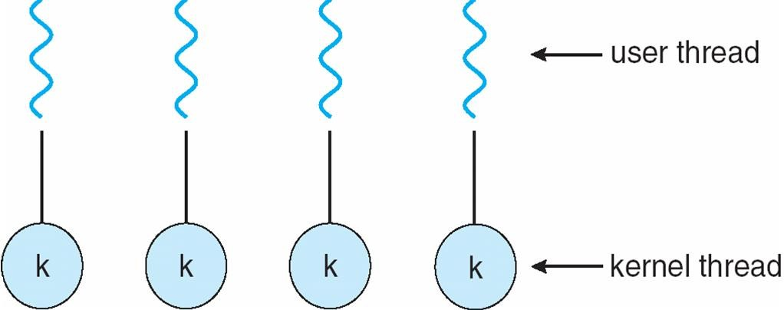
One-to-one Model
The one-to-one model allows for greater concurrency, but the developer has to be careful not to create too many threads within an application

Slide 17
Many-to-One
The many-to-one model associates all user- level threads to a
single kernel-level thread. Examples:
Solaris Green Threads
GNU Portable Threads
true concurrency is not gained because the kernel can
schedule only one thread at a time

Slide 18
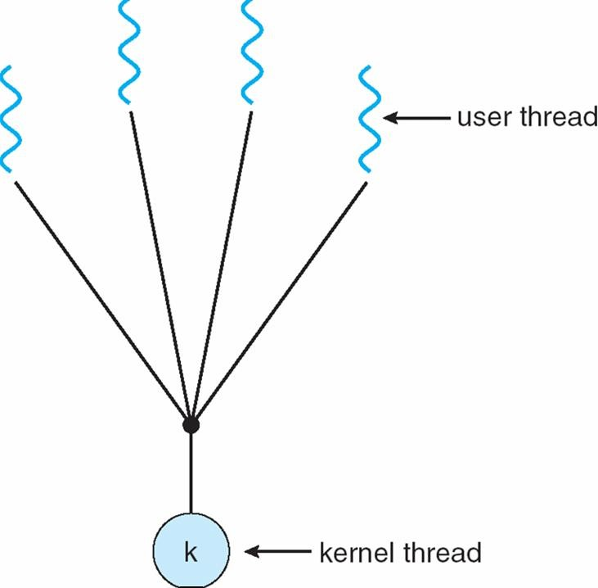
Many-to-One Model

Slide 19
Many-to-Many Model
The many-to-many model is a compromise between the last two models. In this model, a number of user-level threads are associated to an equal or smaller number of kernel-level threads. The Allows many user level threads to be mapped to many kernel threads
Allows the operatingsystem to create a sufficient number of kernel.
Solaris prior to version 9
Windows NT/2000.

Slide 20
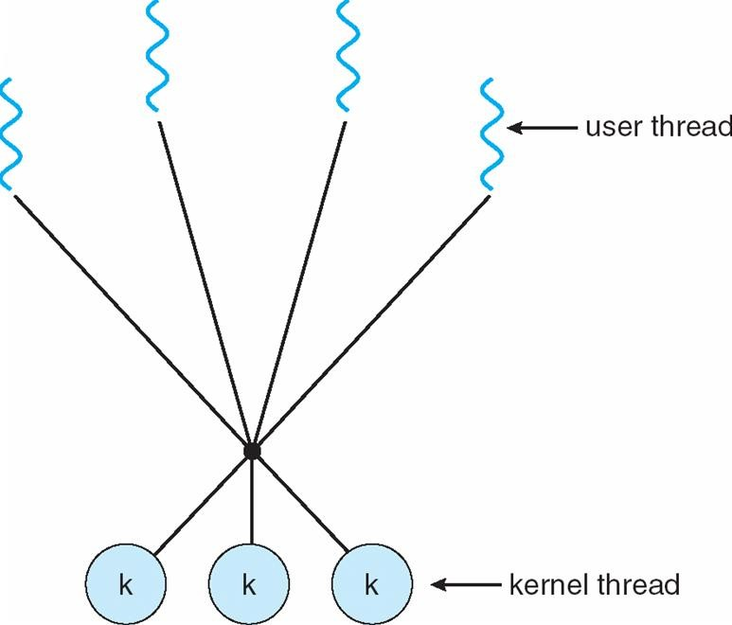
Many-to-Many Model

Slide 21
Thread library
Thread libraries provide programmers with API for creation
and management of threads.
Thread libraries may be implemented either in user space or in kernel space. The user space involves API functions implemented solely within the user space, with no kernel support. The kernel space involves system calls, and requires a kernel with thread library support.
creating and destroying threads
passing messages and data between threads
scheduling thread execution
saving and restoring thread contexts

Slide 22
Thread library
Thread libraries provide the means of thread generations and management in the development of multithreaded applications. The implementation of such libraries are performed via two principal approaches: user and kernel levels.
In the user level approach, all the actual code and data structures are held within the user space such that invoking a library method will result in a call to a local method within the user
space rather than a system call.
In the kernel level approach, the actual code and data structures are held within the kernel space such that invoking a library method results in a system call to the kernel since kernel level libraries are implemented by the operating system itself.
The main thread libraries used today are POSIX Pthreads, Win32 threads and Java threads.

Slide 23
Semantics of fork() and exec()
Does fork() duplicate only the calling thread or all threads?
Some UNIX versions have chosen to have 2 versions of fork()
One that duplicates all the threads.
One that duplicates only one thread.
Exec() call works in the same way.

Slide 24
Thread Cancellation
Thread cancellation is the task of terminating a thread before it has completed.
For example, if multiple threads are concurrently searching through a database and one thread returns the result, the remaining threads might be canceled.
Another situation might occur when a user presses a button on a web browser that stops a web page from loading any further.

Slide 25
A thread that is to be canceled is often referred to as the target thread. Cancellation of a target thread may occur in two different scenarios:
Asynchronous cancellation. One thread immediately terminates the target thread.
The difficulty with cancellation occurs in situations where resources have been allocated to a canceled thread or where a thread is canceled while in the midst of updating data it is sharing with other threads.
Often, the OS will reclaim system resources from a canceled thread but will not reclaim all resources. Therefore, canceling a thread asynchronously may not free a necessary system-wide resource.
Deferred cancellation. The target thread periodically checks whether it should terminate, allowing it an opportunity to terminate itself in an orderly fashion.
With deferred cancellation, in contrast, one thread indicates that a target thread is to be canceled, but cancellation occurs only after the target thread has checked a flag to determine if it should be canceled or not.
This allows a thread to check whether it should be canceled at a point when it can be canceled safely. Pthreads refers to such points
as cancellation points.

Slide 26
Thread Pools
Create a number of threads in a pool where they await work
Advantages:
Usually slightly faster to service a request with an existing thread than create a new thread
A thread pool limits the number of threads that exist at any point. This is important on the systems that cannot support a large number of concurrent threads.

Slide 27
Thread Specific Data
Threads belonging to a process share the data of the process. However in some circum stances each thread might need its own set of data. We call that data “thread specific data.”
Allows each thread to have its own copy of data
Example is a transaction processing system, we might service each transaction in a separate thread.

Slide 28
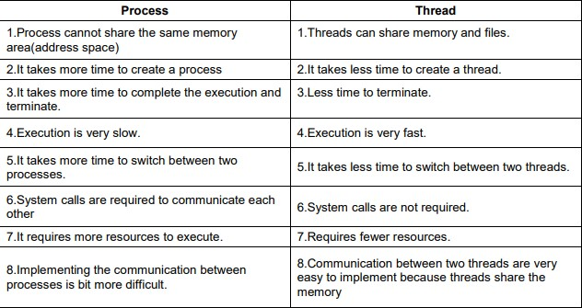
Process vs Thread

